Slide 1
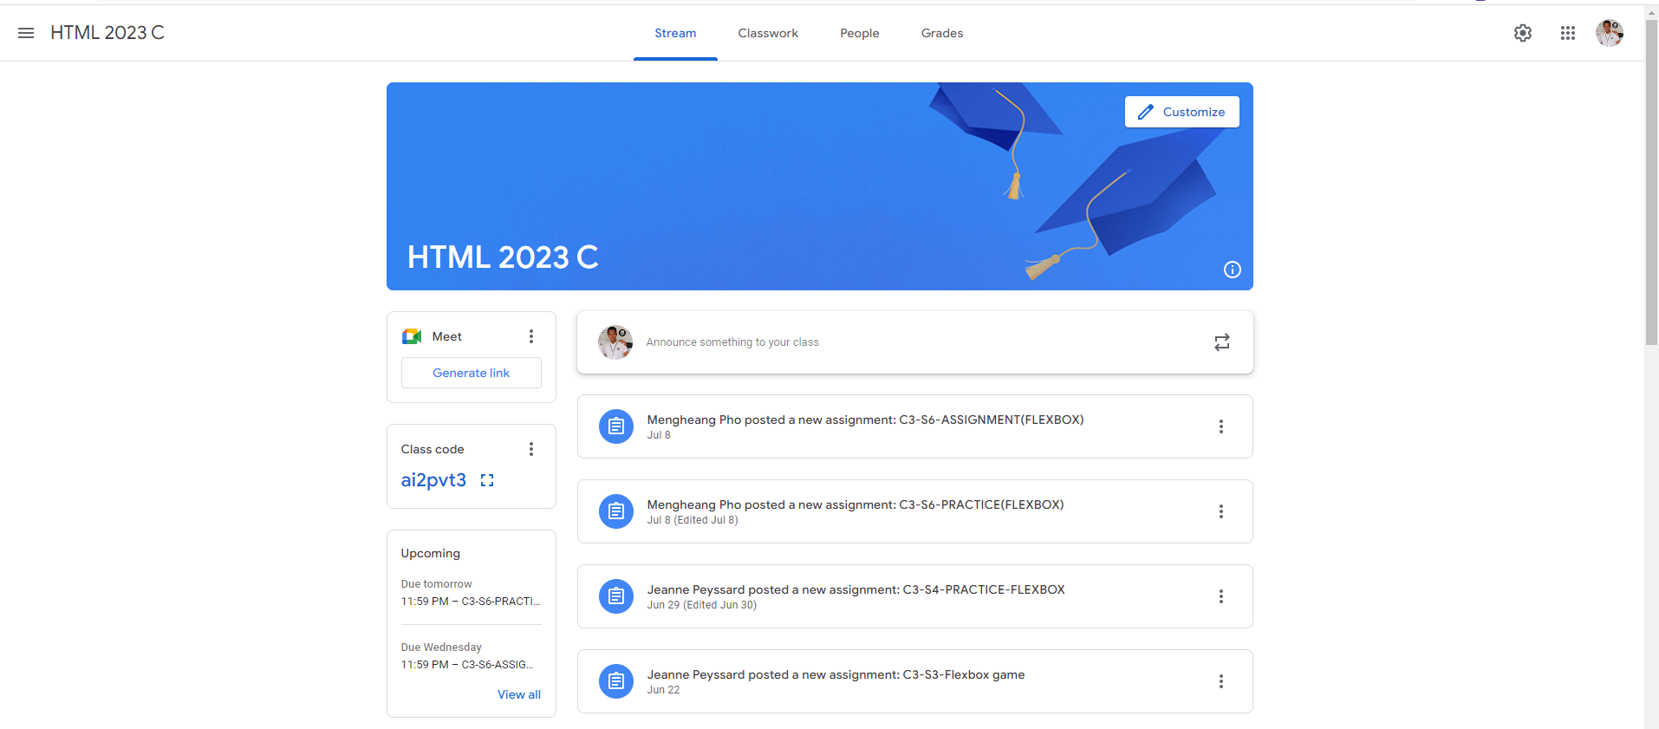
Identify root components of website below

Slide 2
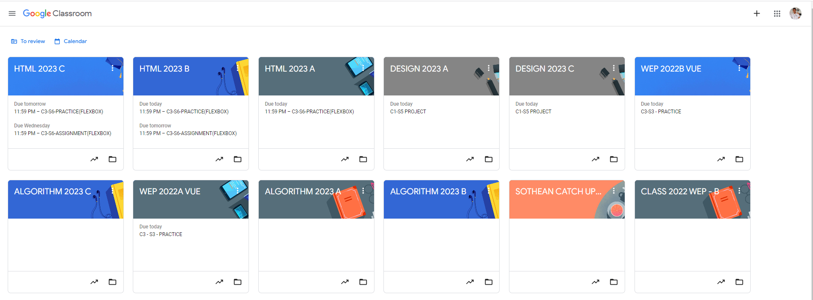
Root div
- Height: 100vh
content
nav
Flex: 0
header
Flex: 0
Flex: 1

Slide 3
Header container
Banner-container
Main-content-container
post-input-container
post-input-container
Main-content-container
post-input-container
post-input-container
Sidebar-container
post-input-container

Slide 4
Header-container
Logo Container
Navigation Tabs Container
Icons/Settings Container

Slide 5
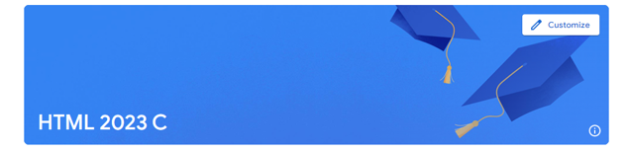
Banner-Container
Banner Text Container
Customize Button Container

Slide 6


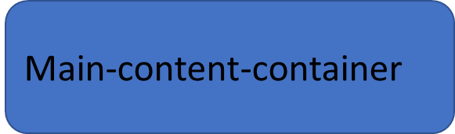
Main-content-container
Sidebar Container
Sidebar Container

Slide 7
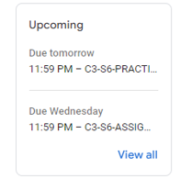
Sidebar-container
Upcoming Tasks Container

Slide 8
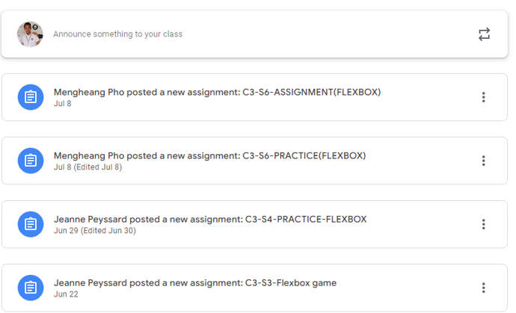
post-input-container
post-header
profile-section
button

